Slide 1
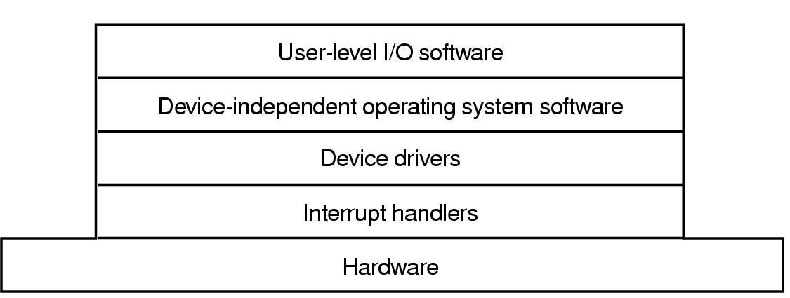
I/O Software Layers
Copyright ©: Nahrstedt, Angrave, Abdelzaher
Layers of the I/O Software System

Slide 2
Device Drivers
What are Device Drivers
What are they used for
Why are they important
Provide Uniform APIs to access Hardware

Slide 3
Device Drivers
Why do we need Device Drivers
Custom Platform
Device Drivers to allow application to access peripheral Devices

Slide 4
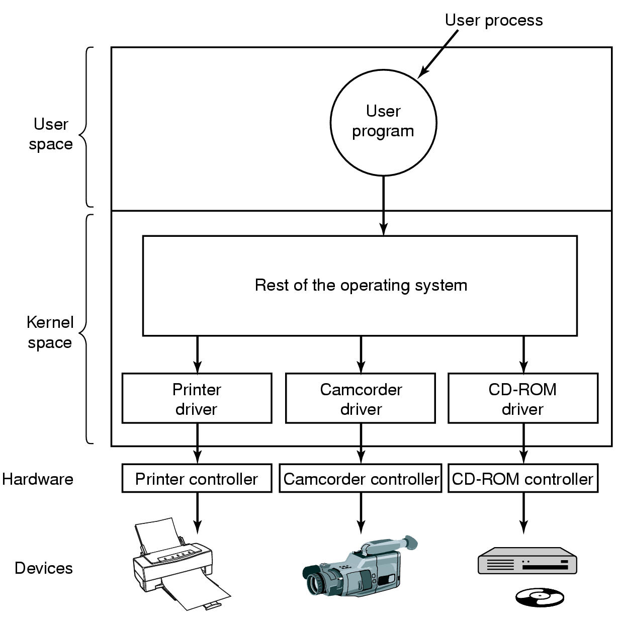
Device Drivers
Logical position of device drivers is shown here
Communications between drivers and device controllers goes over the bus

Slide 5
Device Drivers
Device-specific code to control an IO device, is usually written by device's manufacturer
  Each controller has some device registers used to give it commands. The number of device registers and the nature of commands vary from device to device (e.g., mouse driver accepts information from the mouse how far it has moved, disk driver has to know about sectors, tracks, heads, etc).
A device driver is usually part of the OS kernel
  Compiled with the OS
  Dynamically loaded into the OS during execution
Each device driver handles
  one device type (e.g., mouse)
  one class of closely related devices (e.g., SCSI disk driver to handle multiple disks of different sizes and different speeds.).
Categories:
  Block devices
  Character devices

Slide 6
Functions in Device Drivers
Accept abstract read and write requests from the device-independent layer above;
Initialize the device;
Manage power requirements and log events
Check input parameters if they are valid
Translate valid input from abstract to concrete terms
  e.g., convert linear block number into the head, track, sector and cylinder number for disk access
Check the device if it is in use (i.e., check the status bit)
Control the device by issuing a sequence of commands. The driver determines what commands will be issued.

